Slide 1

Weather Risk Anlyst
^{20/02/2018}
Weather Forecast
Laurent Politis

Slide 2
PLAN
Pacific
El niña
MJO
Europe
Teleconnexion MJO
NAO
Forecast
Impact on the market

Slide 3
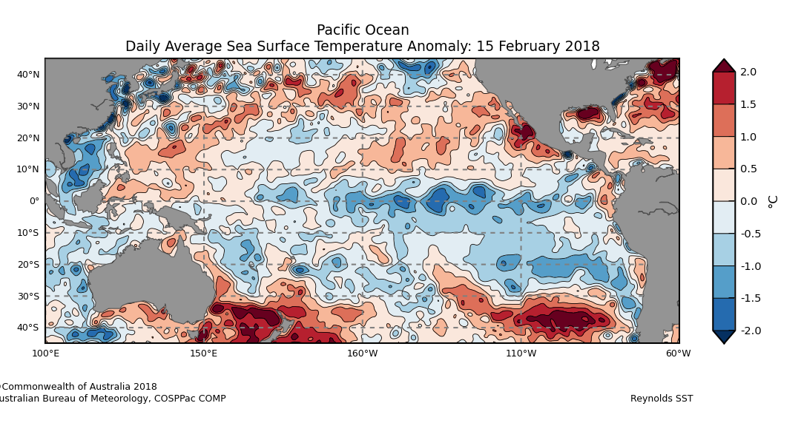
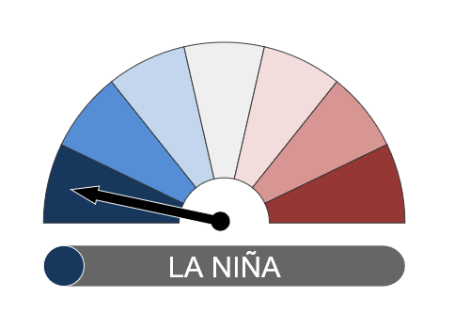
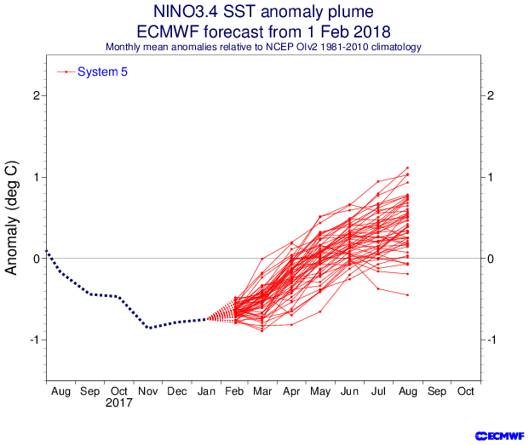
ENSO
Outlook
Current state La niña
Increase probability of cyclone formation in
western Pacific
Decrease sst for March
End of el niña advance by the current MJO in phase 7
Maybe neutral ENSO for April and Mays

Slide 4
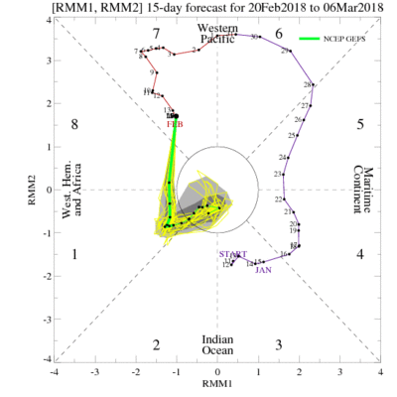
MJO – Madden Julian Oscillation
Outlook
Strong MJO until 7 and 8 February in the western Pacific
Weaken el Nina condition due to MJO
Weaken MJO in the next days move eastward rapidly into phase 8 to phase 1
Teleconnexion sudden Stratospheric Warming Events due to powerful MJO event

Slide 5
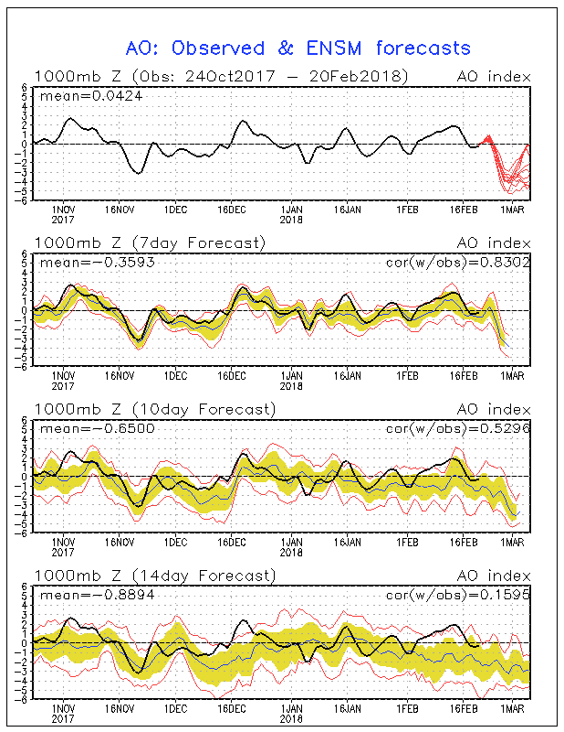
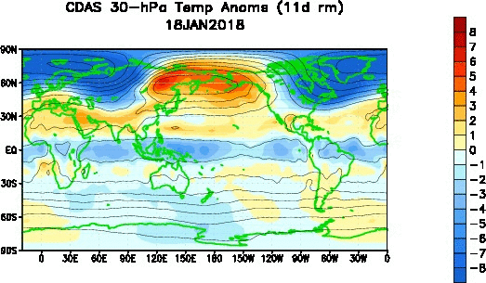
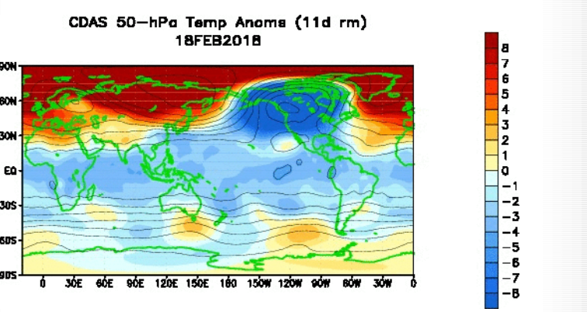
Teleconnections
MJO Impacts on Artic Oscillation
blocking occurs preferentially during the low AO phase the North Atlantic and Russia
For the next days we have a sharp decrease in the Ao index
High stratospheric warming can be observed

Slide 6
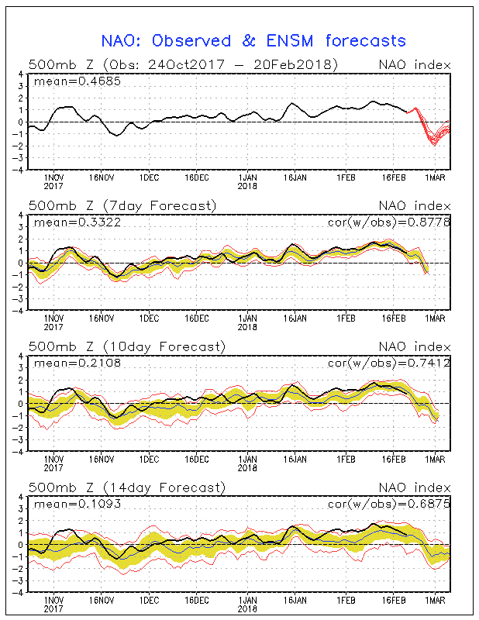
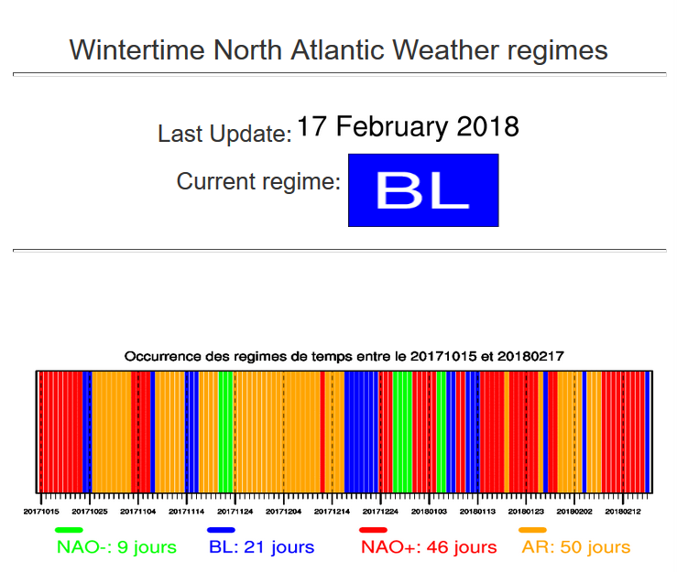
Teleconnections
MJO Impacts on North Atlantic Oscillation
After a long phase of a NAO+ state we are no in a Blocking situation evolving into a NAO- situation for the next week

Slide 7
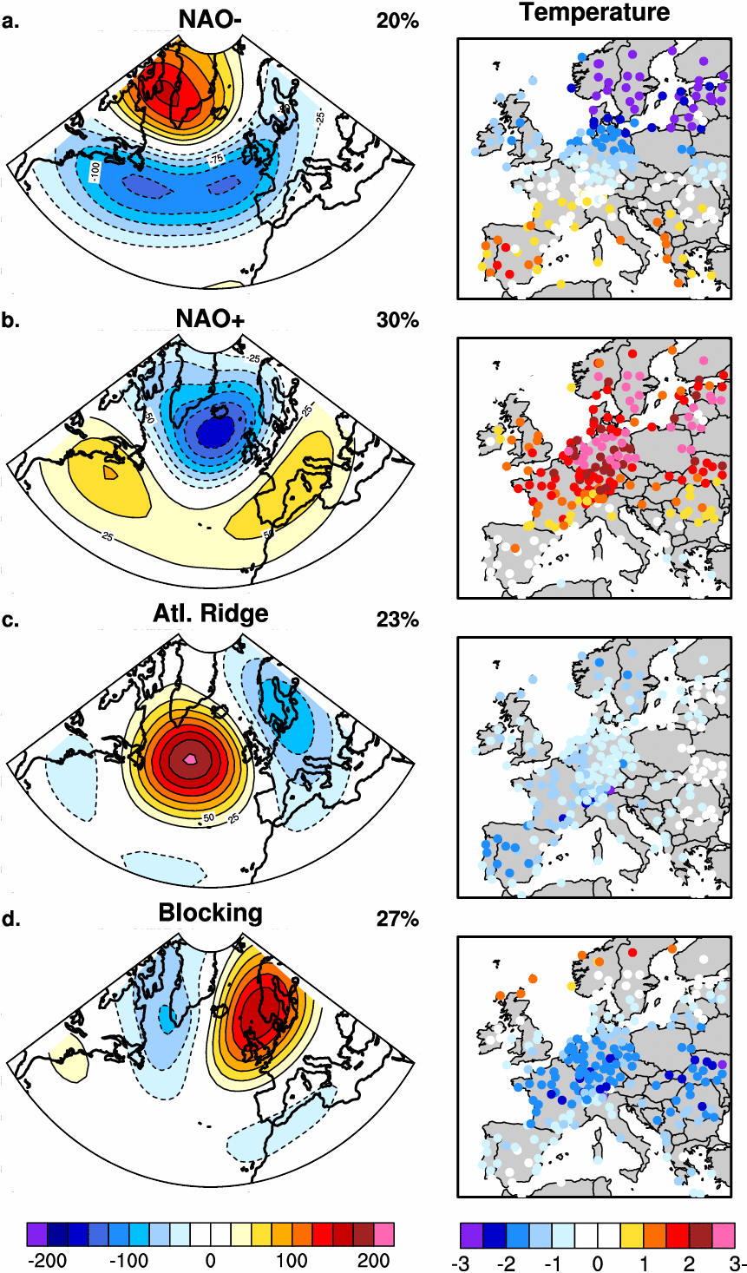
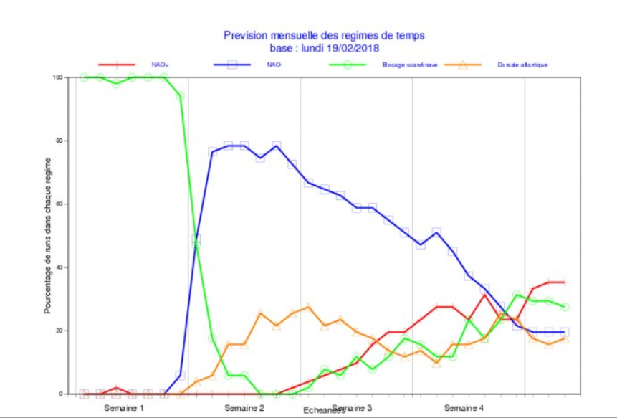
Teleconnections
Impacts on temperatures
for this week a Blocking situation is expected
decrease in temperatures

Slide 8
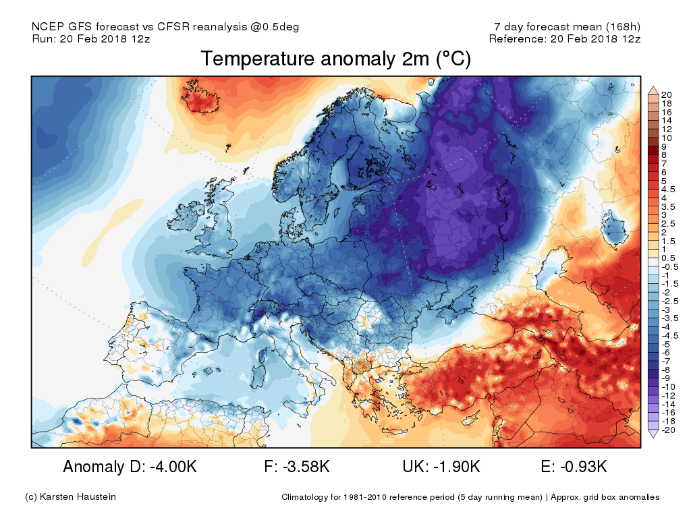
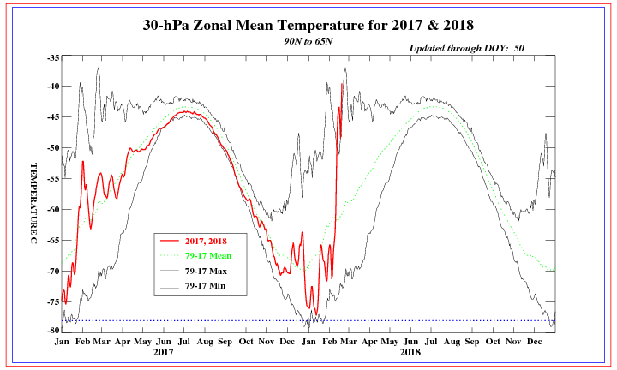
Impact on temperature
Outlooks
Cold situation is Widespread in Europe by the east

Slide 9
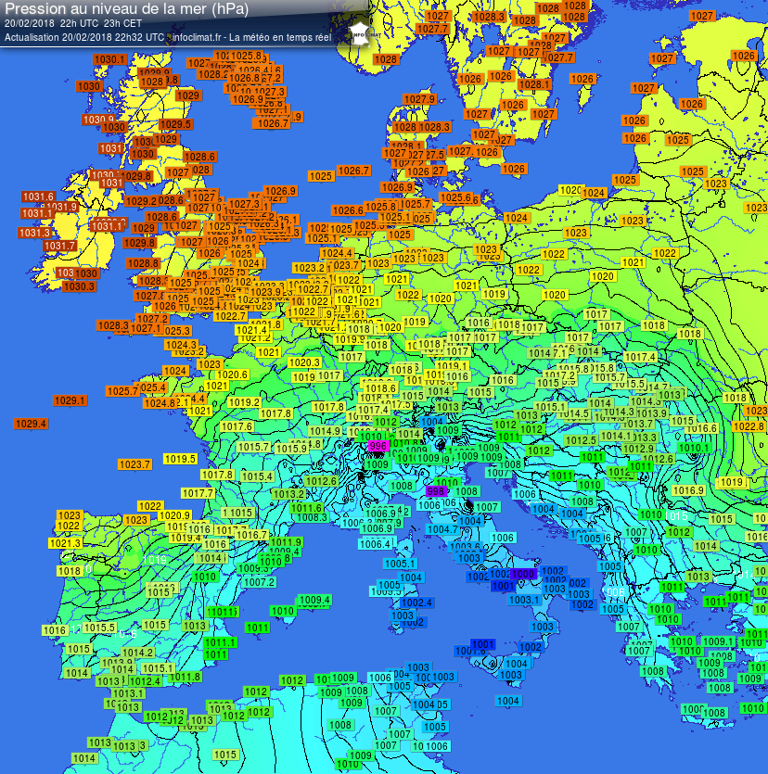
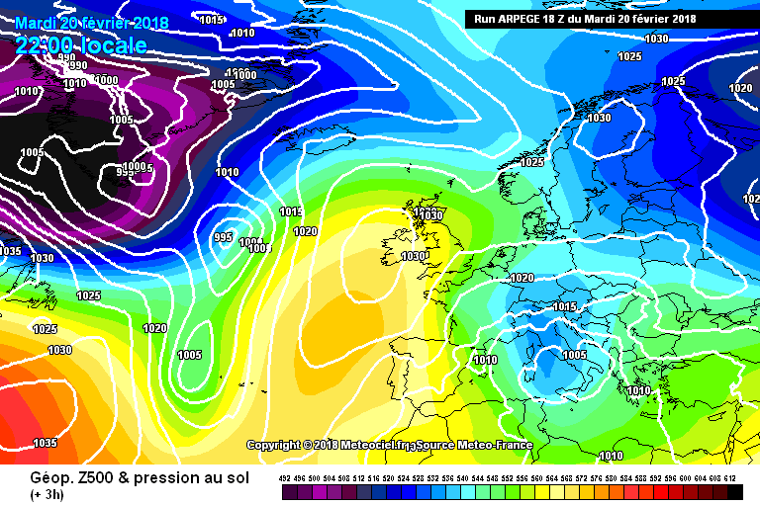
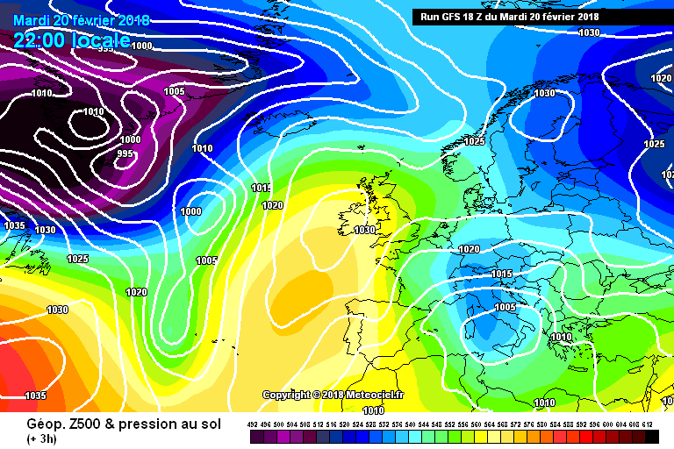
Europe
Analysis
Arpege and GFS very similar with the observation Thursday 22h00 (local)

Slide 10
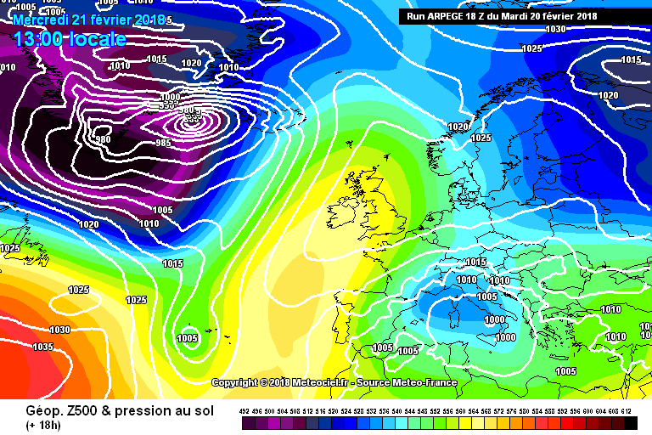
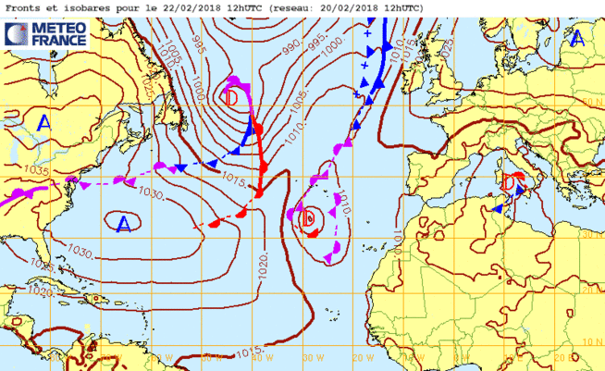
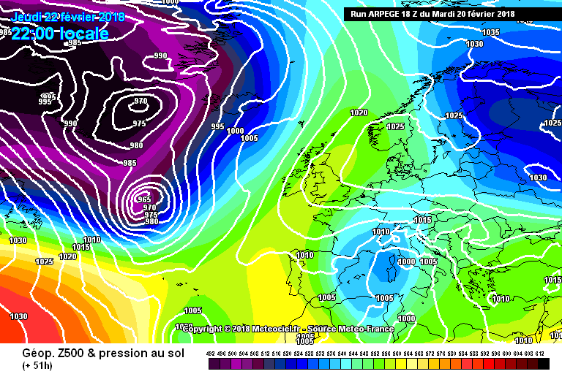


Europe – D+1 to D+2 Arpege (Météo France)
Forecast D+1 Geop à 500 h/PSL
Presyg D+2
Forecast D+2
D+1 to D+2 a Cold drop centered on the western coast of Italy (Blocking situation) will bring a sharp drop in temperature
north-easterly wind for J +1 to +2 increase in strength for the next day

Slide 11
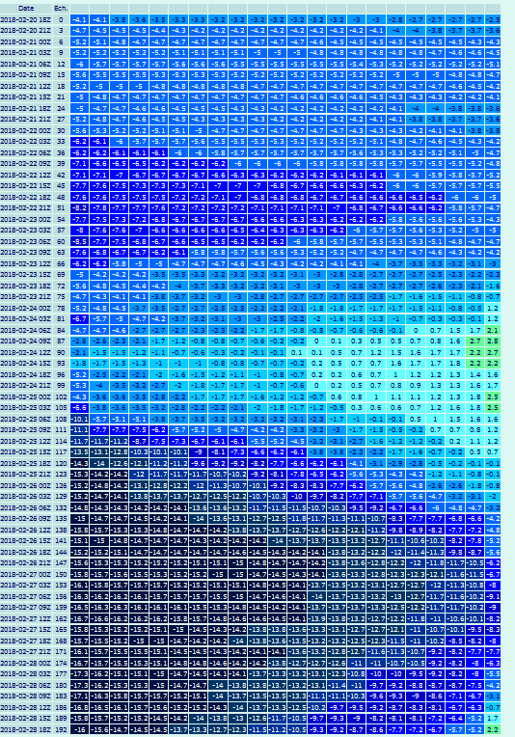
Europe – Ensemble Forecast for the next days
J+5 and more
Blocking and then NAO- situation
Widespread and exceptionally cold conditions will dominate across all major European through and beyond the end of the month
possible snowfall isn’t excluded

Slide 12
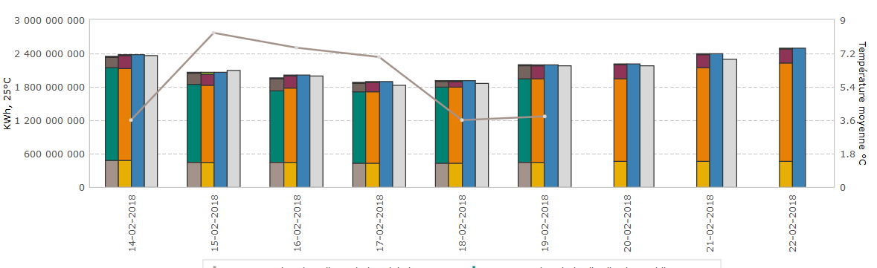
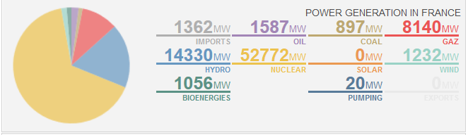
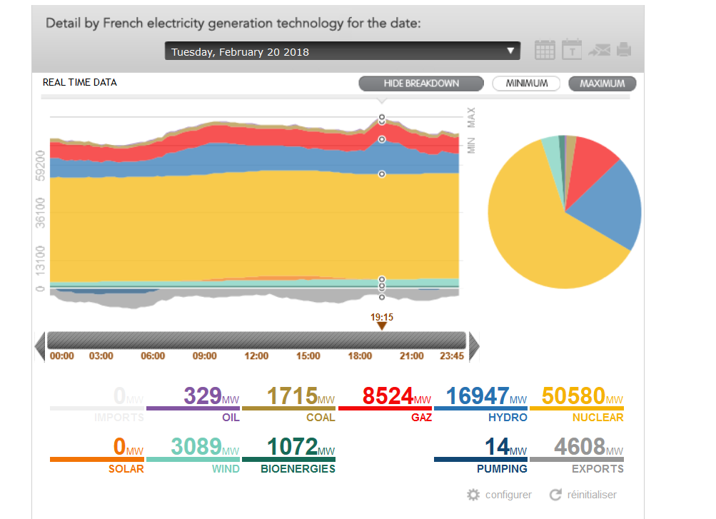
Impact on Gaz consumption
Insight
High hydraulics potential power (above normal snowfall this winter)
Rise of the consumption for the next days and for next week with this Blocking situation
Increase power from
wind farm

Slide 13
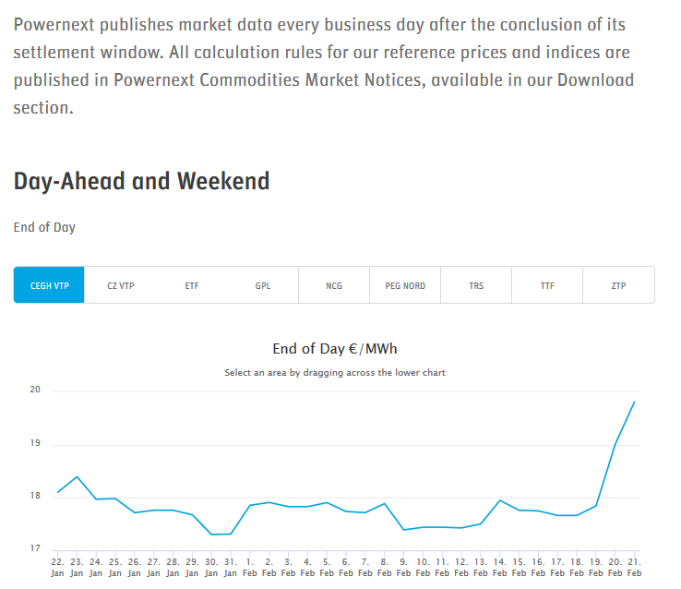
Impact on Gaz price

Slide 14
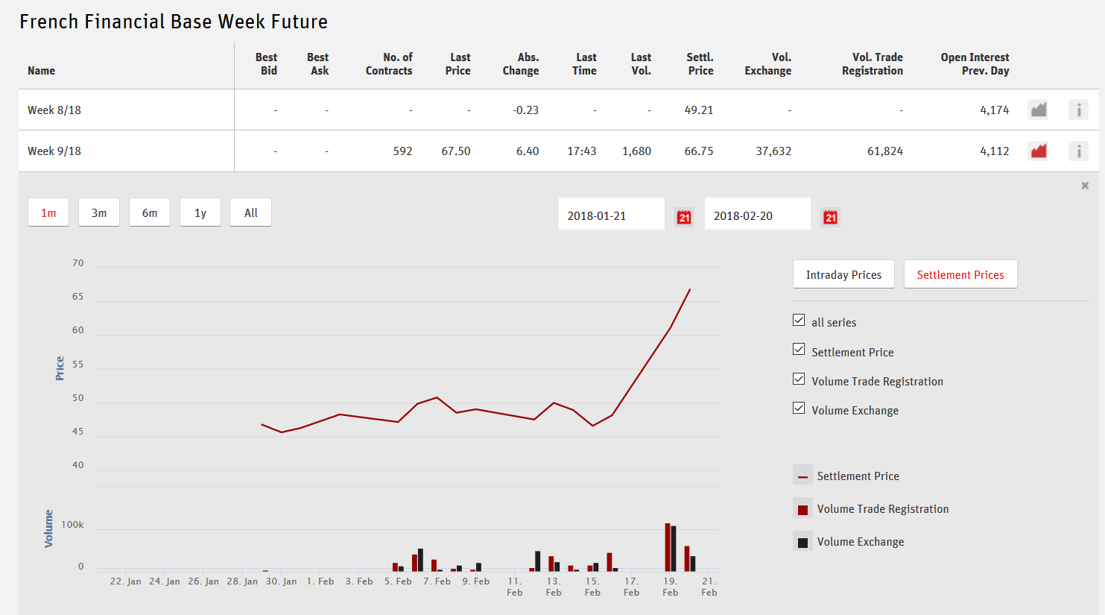
Impact on Gaz price

Slide 15
Old slide

Slide 16
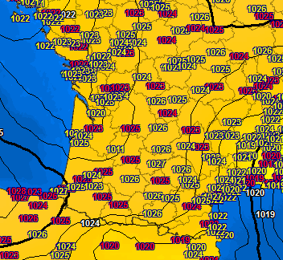
Europe
Analysis
for this run (2018/02/18 06H00) Arpege is better for the psl forecast than GFS

Slide 17

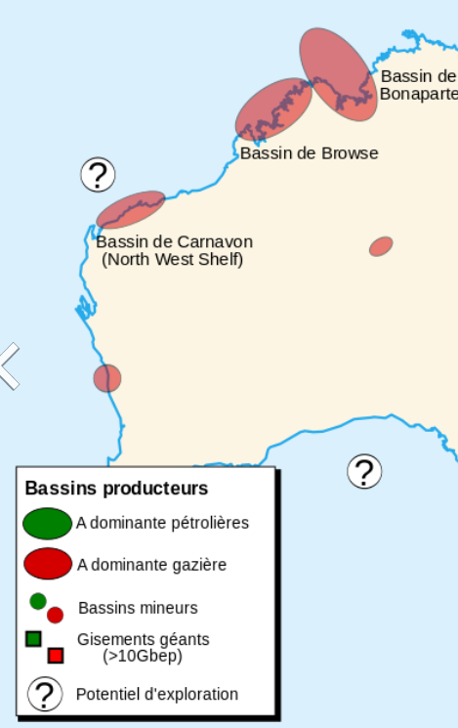
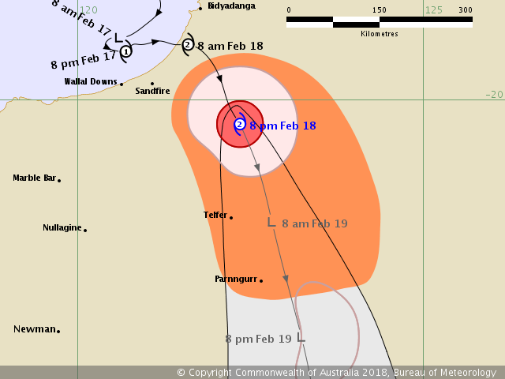

Old slide - Cyclone Activities -
Cyclone Kelvin
Cat 2 wind between
more than 153 km/h
Swell expected 3 and 4 m
Will decrease and fall to a tropical depression
(End of el Niña advanced)

Slide 18
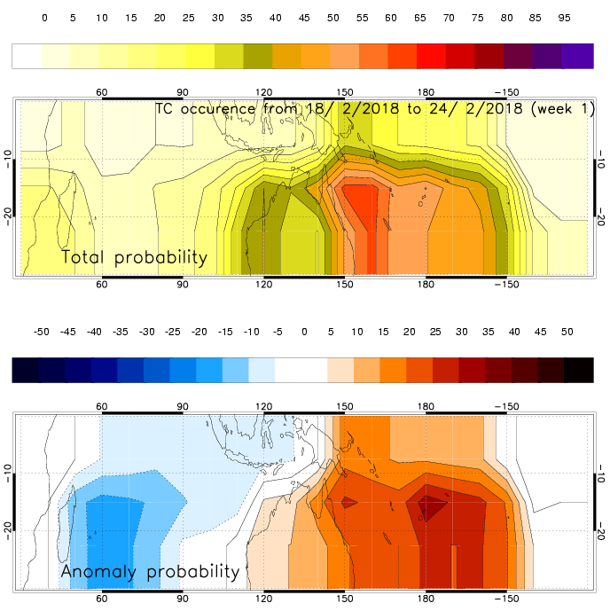
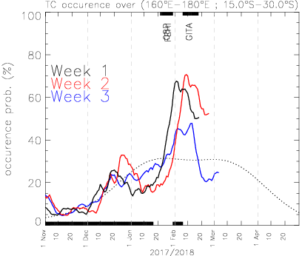
Madden Julian Oscillation and Cyclone relation
Outlook
Gita and Kelvin maybe related to the MJO
Increase in convection and Rainfall due to MJO

Slide 19
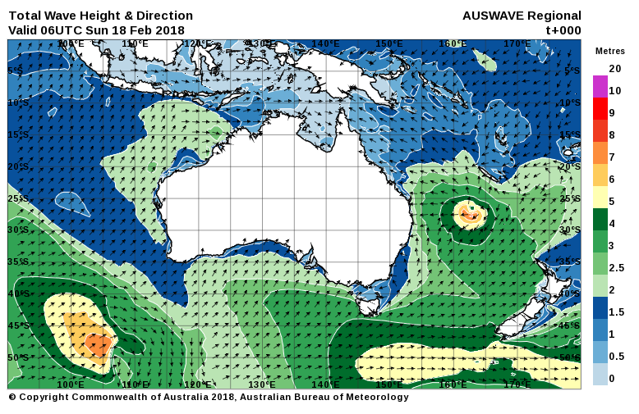
Cyclone Activities
Cyclone Kelvin
Cat 1 wind between
119 & 153 km/h
Swell expected at maximum 3

Slide 20
Cyclone Activities
Cyclone Gita
Swell expected maximum 8-7m total wave height
Cat 2 to 1 and for next days into a tropical low depression

